Slide 1
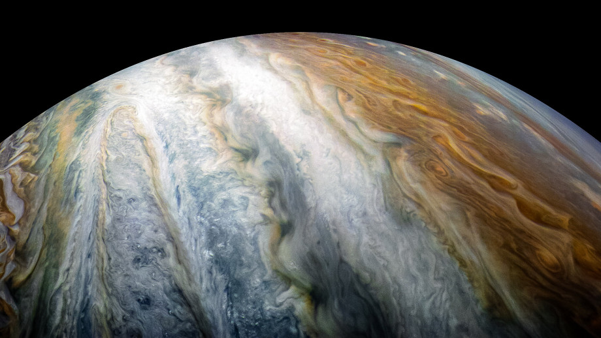
PowerShell in Notebooks
Rob Sewell
Notes:
[REQUIRED SLIDE]

Slide 2
How to insert your Twitter handle
1. On the Insert tab, select Header & Footer.
2. On the Slide tab, check the Footer box.
3. In the box below Footer, type your Twitter handle (e.g. @PSConfEU).
4. To prevent the footer from appearing on the title slide, check the Don't show on title slide box.
5. Click Apply to All button.

Slide 3
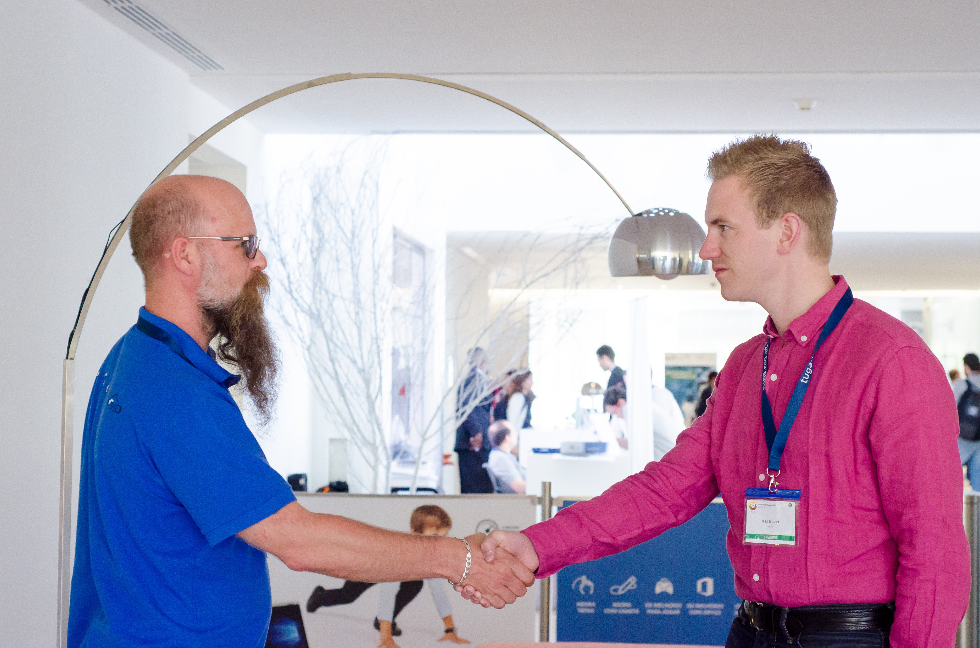
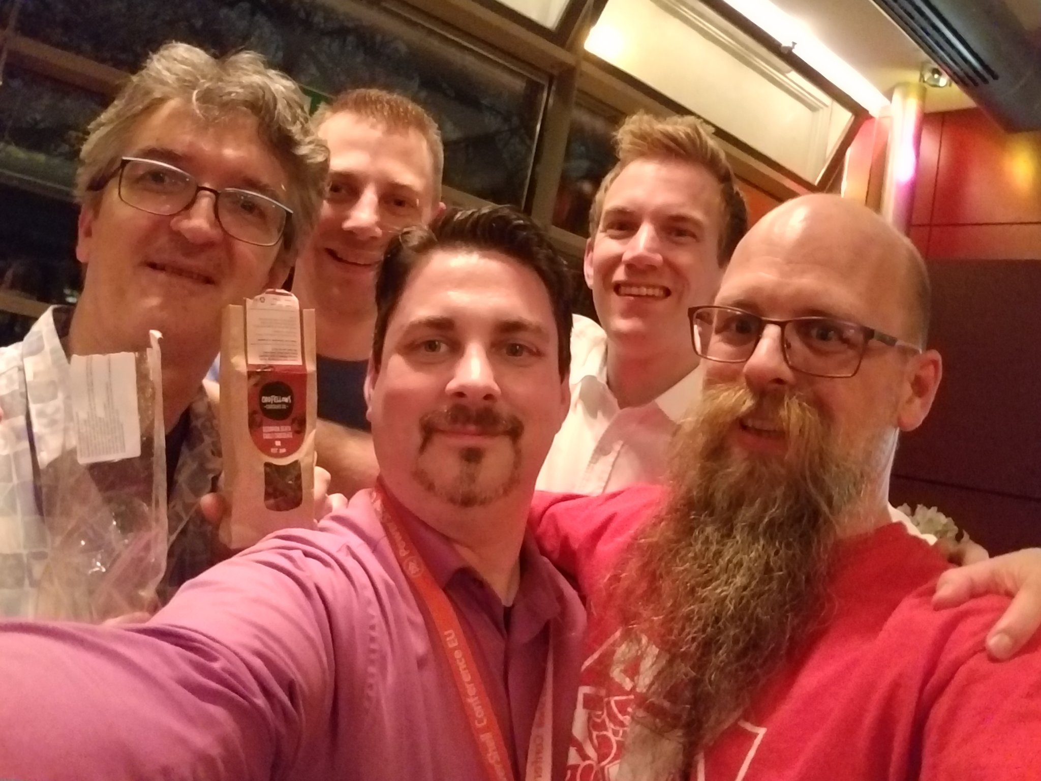
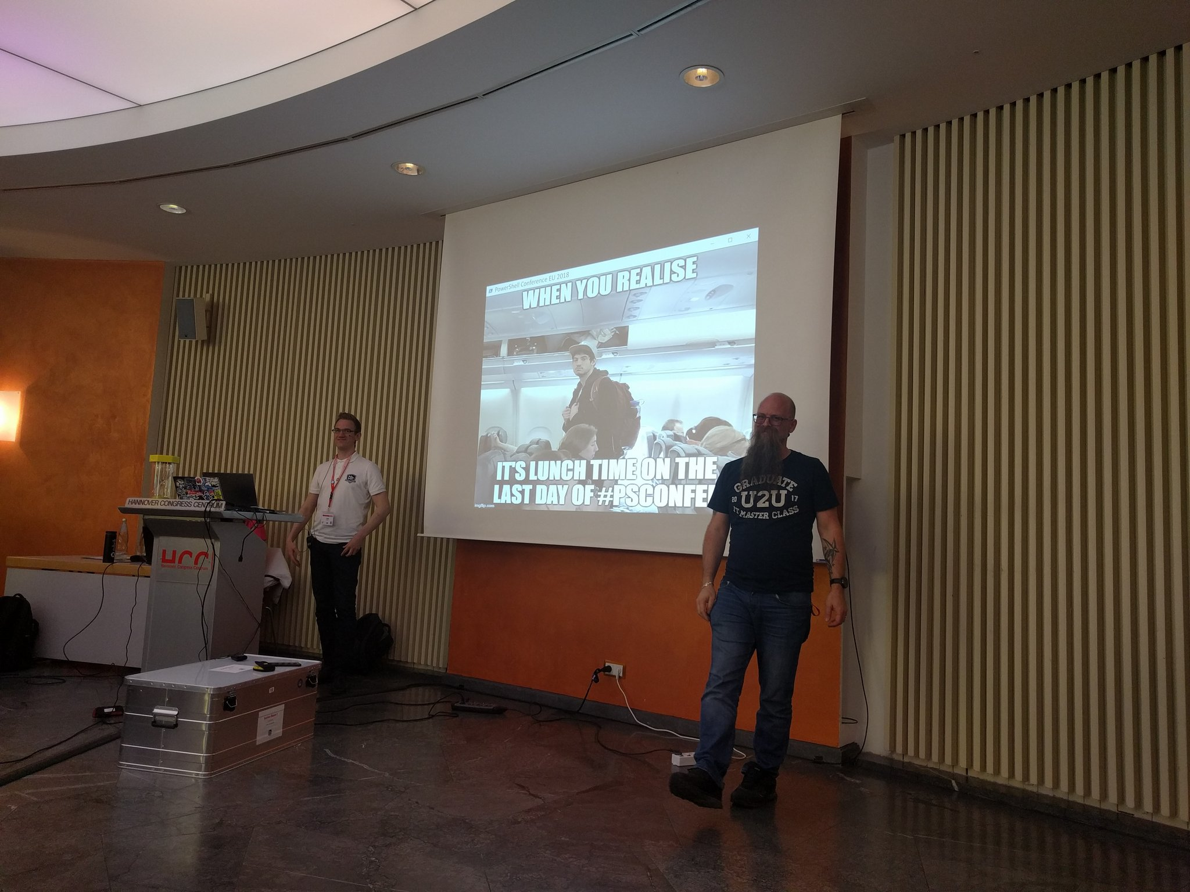

Slide 4
THANK YOU
Notes:
[REQUIRED SLIDE]

Slide 5
PowerShell in Notebooks
Rob Sewell
Notes:
[REQUIRED SLIDE]

Slide 6
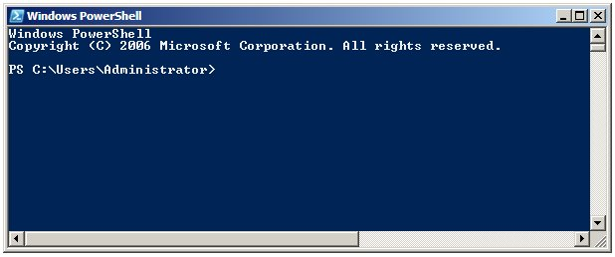
Running PowerShell
2006

Slide 7
Running PowerShell
2006

Slide 8
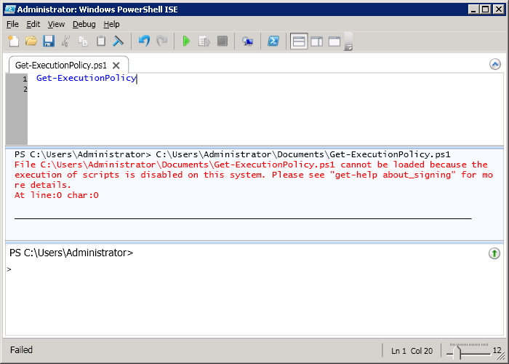
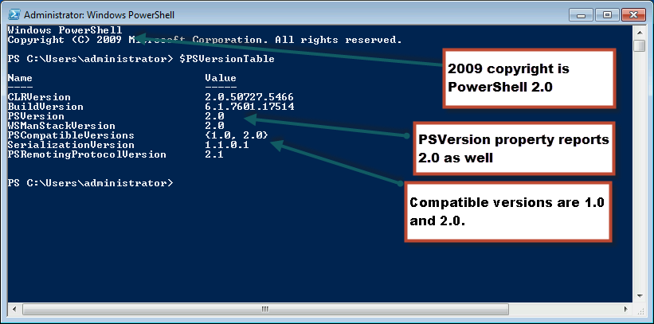
Running PowerShell
2010

Slide 9
Running PowerShell
2010

Slide 10
Running PowerShell
2010

Slide 11
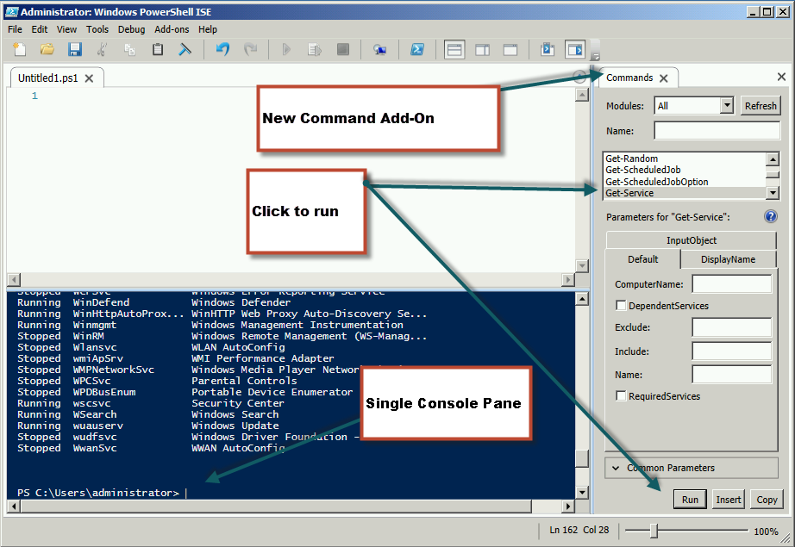
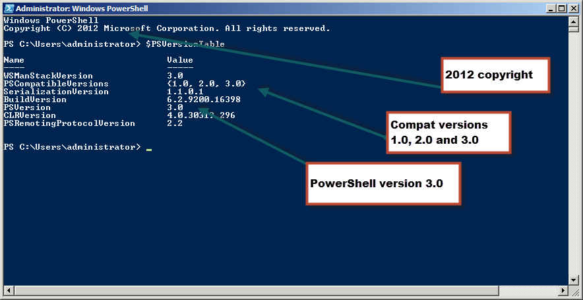
Running PowerShell
2012

Slide 12
Running PowerShell
2012

Slide 13
Running PowerShell
2012

Slide 14
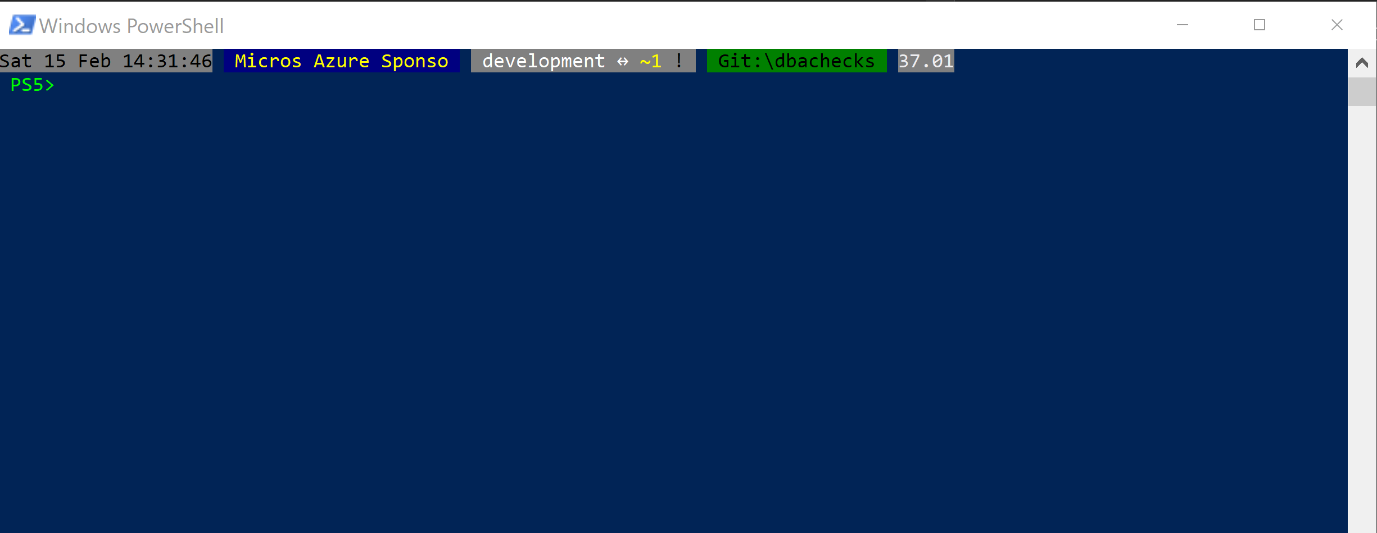
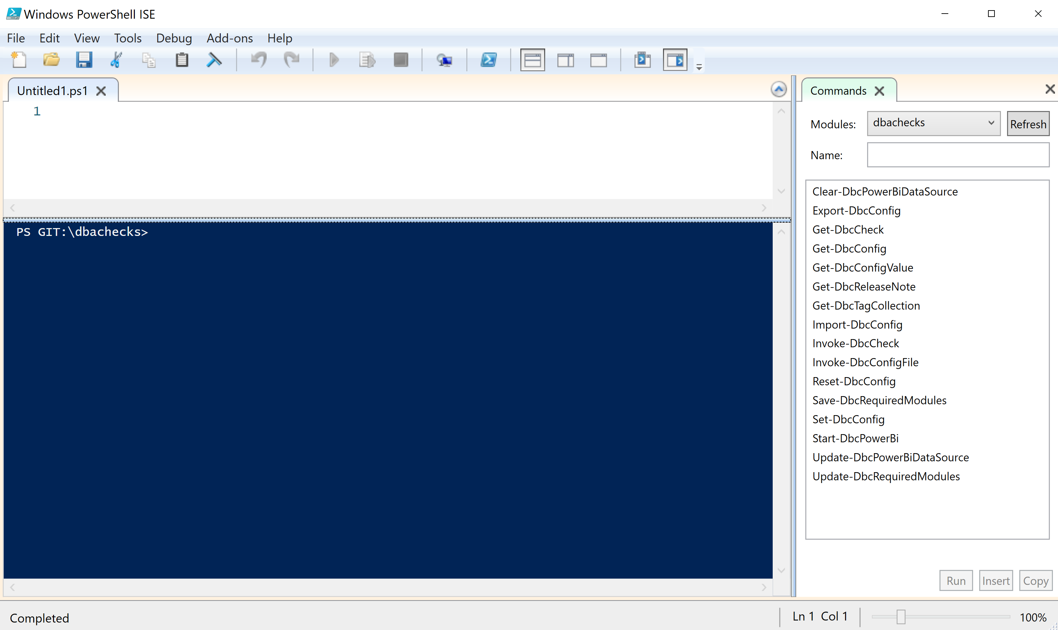
Running PowerShell
2017

Slide 15
Running PowerShell
2017

Slide 16
Running PowerShell
2017

Slide 17
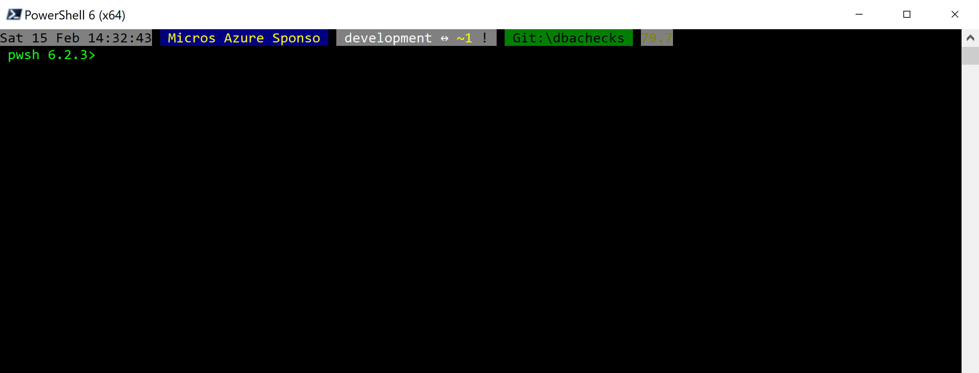
Running PowerShell
2018

Slide 18
Running PowerShell
2018

Slide 19
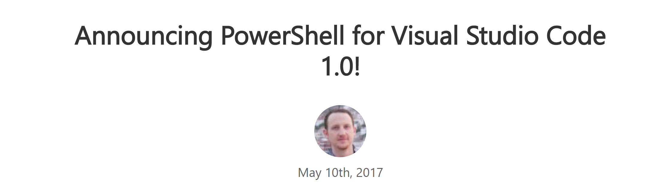
Running PowerShell
2016-17

Slide 20
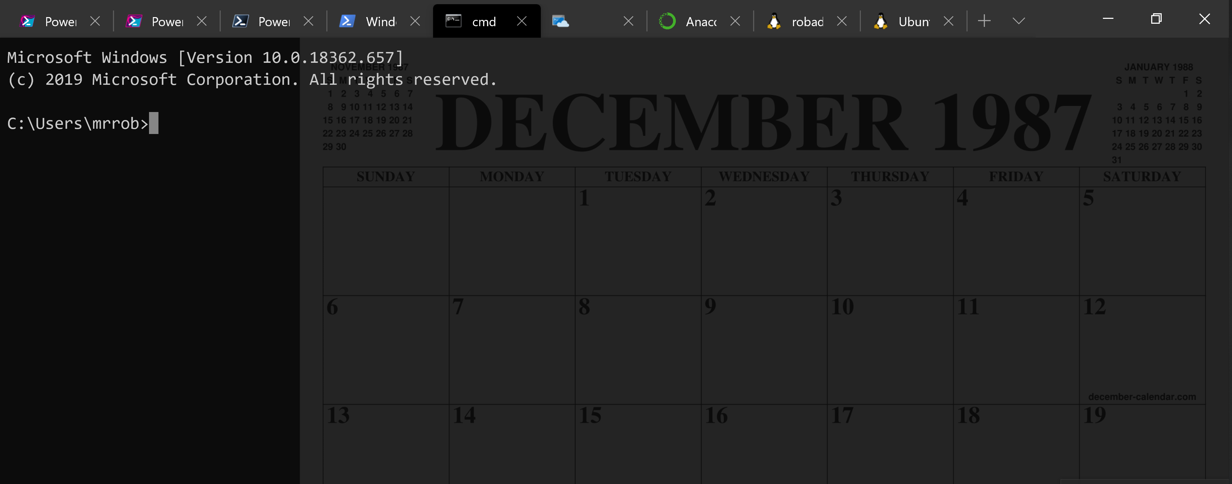
Running PowerShell
2016-17

Slide 21
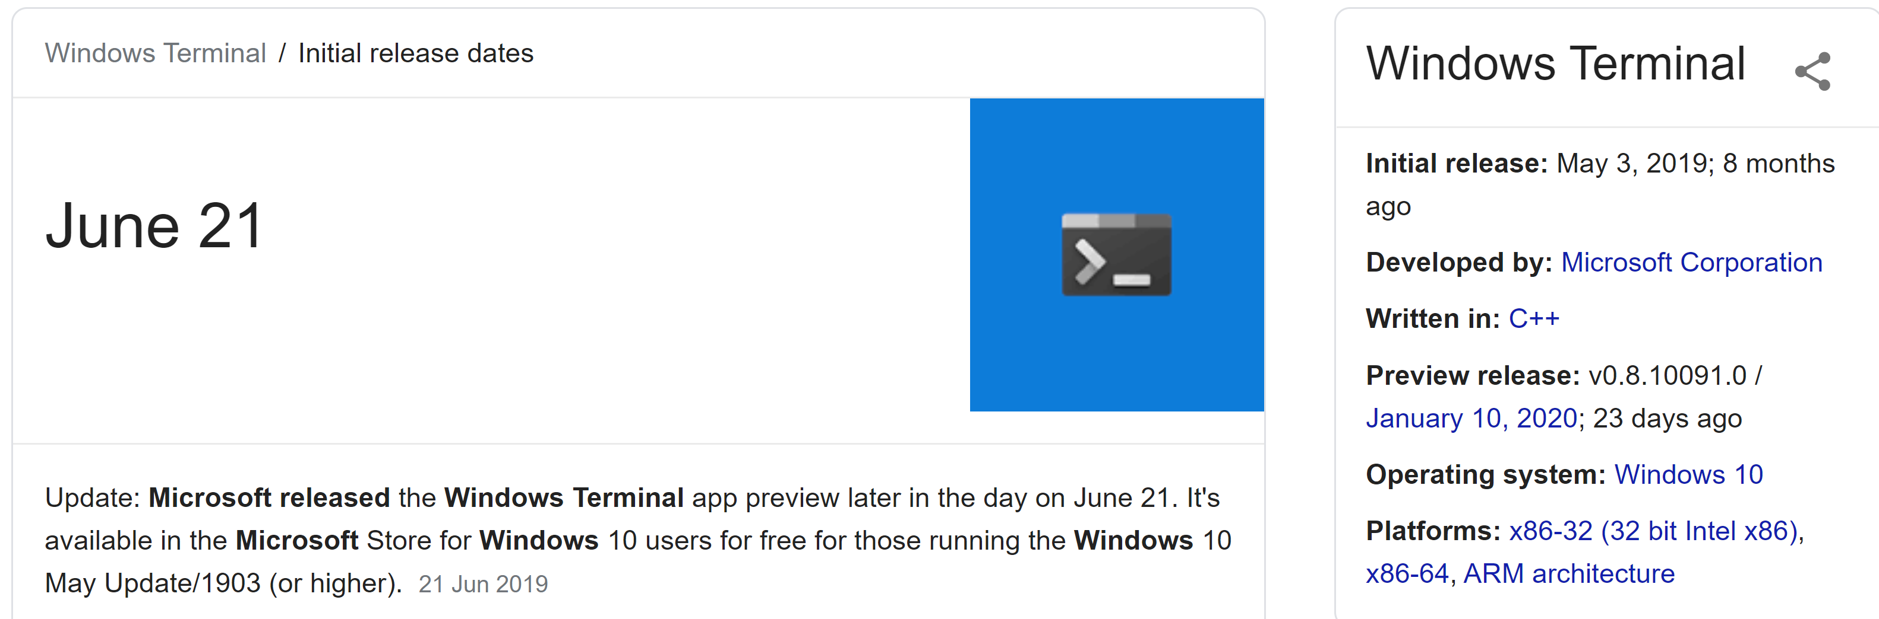
Running PowerShell
2019

Slide 22
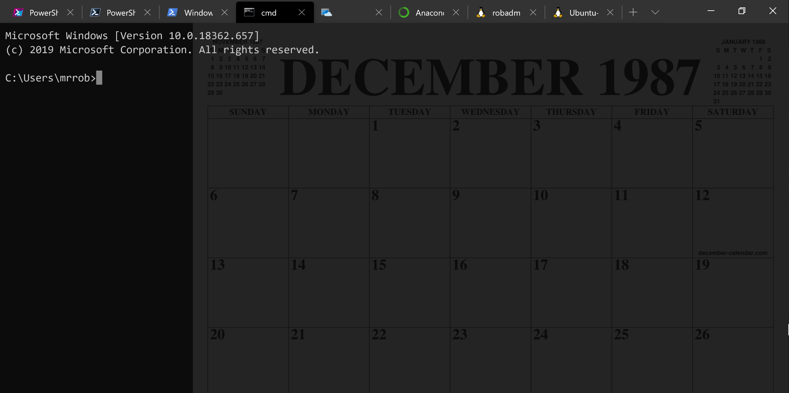
Running PowerShell
2019

Slide 23
Running PowerShell
2019

Slide 24
A Decade and a Half

Slide 25
Uh, Houston, we've had a problem
https://en.wikipedia.org/wiki/Houston,_we_have_a_problem

Slide 26
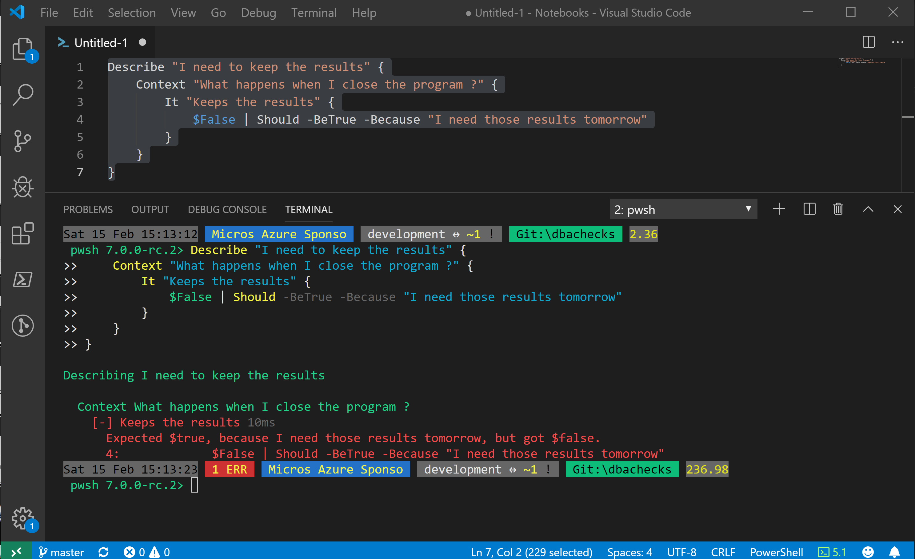
Without some effort………..

Slide 27
Without some effort………..

Slide 28
Without some effort………..

Slide 33
ALL
GONE

Slide 34
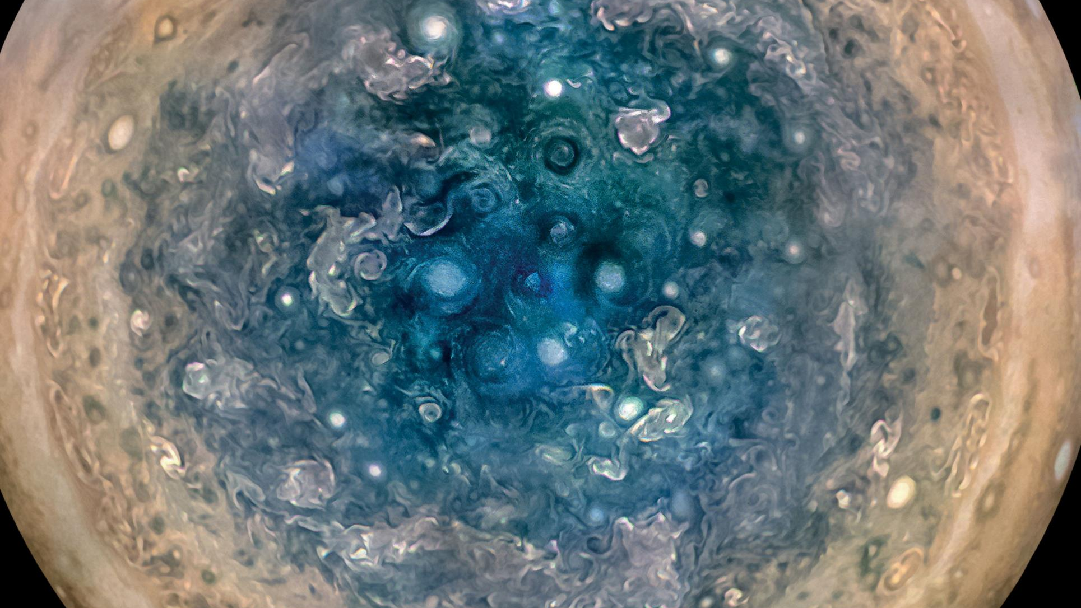

Slide 35
First, the names comes from the planet Jupiter. We wanted to pick a name that evoked the traditions and ideas of science.
Jupyter

Slide 36
Jupyter
First, the names comes from the planet Jupiter. We wanted to pick a name that evoked the traditions and ideas of science.
Second, the core programming languages supported by Jupyter are Julia, Python and R. While the name Jupyter is not a direct acronym for these languages, it nods its head in those directions. In particular, the "y" in the middle of Jupyter was chosen to honor our Python heritage. See the logos of these languages in the languages folder of this repo.
https://github.com/jupyter/design/wiki/Jupyter-Logo

Slide 37
Jupyter
Second, the core programming languages supported by Jupyter are
Julia, Python and R.
While the name Jupyter is not a direct acronym for these languages, it nods its head in those directions.
In particular, the "y" in the middle of Jupyter was chosen to honor our Python heritage.
Third, Galileo was the first person to discover the moons of Jupiter. His publication on the moons of Jupiter is an early example of research that includes the underlying data in the publication. This is one of the core ideas and requirements for scientific reproducibility. Reproducibility is one of the main focuses of our project.
https://github.com/jupyter/design/wiki/Jupyter-Logo

Slide 38
Jupyter
Third, Galileo was the first person to discover the moons of Jupiter. His publication on the moons of Jupiter is an early example of research that includes the underlying data in the publication.
This is one of the core ideas and requirements for scientific reproducibility. Reproducibility is one of the main focuses of our project.
https://github.com/jupyter/design/wiki/Jupyter-Logo

Slide 39

What is a Jupyter Notebook?
Originally for Data Scientists

Slide 40
What is a Jupyter Notebook?
Document that can contain text, code, images and query results

Slide 41
What is a Jupyter Notebook?
Document that can contain text, code, images and query results

Slide 42
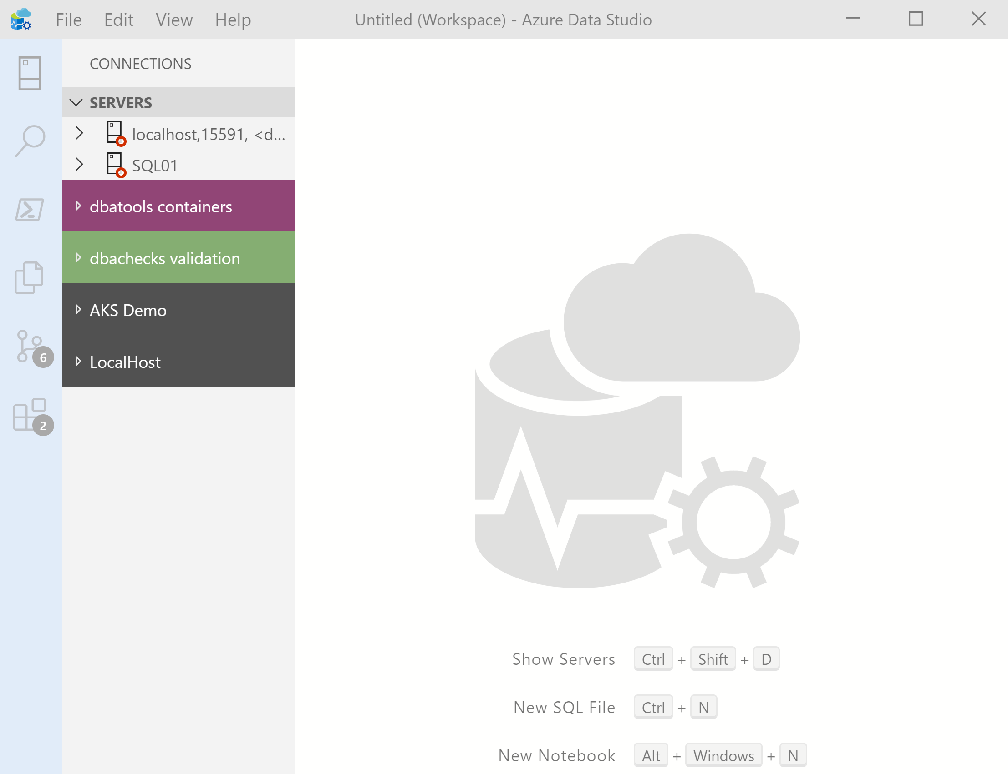

What’s Azure Data Studio ?
Cross Platform desktop environment for Data Professionals

Slide 43
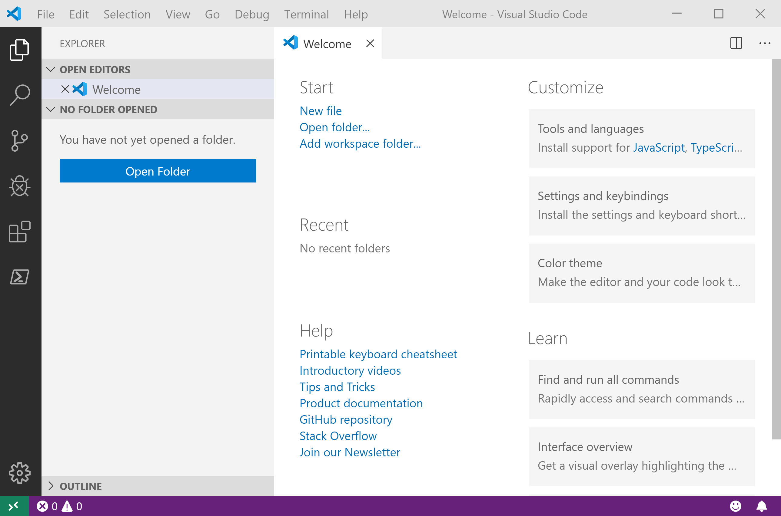
It Looks Like Visual Studio Code ?

Slide 44
It Looks Like Visual Studio Code ?

Slide 45
.NET Interactive Notebooks
Announced at Ignite but preview announced with PowerShell February 6th 2020 https://devblogs.microsoft.com/dotnet/net-interactive-is-here-net-notebooks-preview-2/

Slide 46
.NET Interactive Notebooks
All the goodness of Jupyter Notebooks with added
PowerShell (and C#) (and F#)

Slide 47
Enough talk
Lets see it!
beard.media\book
@sqldbawithbeard
SQLDBAWithABeard.com

Slide 48
Enough talk
All of Robs code can be found on his Github https://github.com/sqldbawithabeard
All of the presentations are in the Presentations Repo
The Notebooks used today can be found in the JupyterNotebooks Rep

Slide 49
Notes:
[REQUIRED SLIDE]

Slide 50
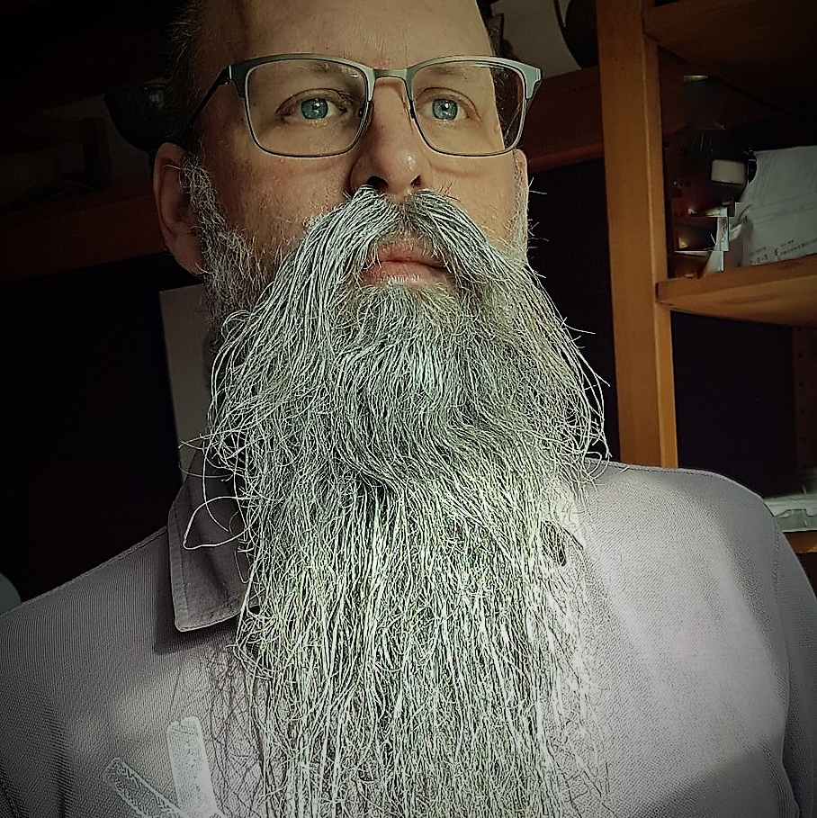
Rob Sewell
about_Speaker
Bearded Consultant, Automator,
Trainer
Consultant Sewells Consulting Ltd
dbatoolsMoL dbachecks PowerShell & Data Community
beard.media\book
@sqldbawithbeard
SQLDBAWithABeard.com

Slide 51

Delegate sign-up opens November 2020 at https://psconf.eu
Notes:
[REQUIRED SLIDE]

